Slide 1
Eco-spark: Solar Product on E-commerce Platform
By:
Name: Bandita Senapati
Roll no: 2305260006

Slide 2
Content
1.Objective
2. Overview
3.Importance of Solar Product
4. Importance of Frontend Development in E-Commerce
5. Role of Spring Boot in Backend Development
6. Importance of Database Selection in E-Commerce
7. High-Level Architecture Diagram Of E-Commerce Site
8. Role of APIs in E-Commerce
9. Security Measures in Spring Boot
10. User Authentication & Authorization
11. Admin Panel for Product Management
12.Conclusion

Slide 3
What Are Solar Products ?
Definition: Solar products are devices that harness solar energy from the sun and convert it into usable power for various applications.
Working Principle: Most solar products use photovoltaic (PV) cells to convert sunlight into electricity. Some products also use solar thermal energy.

Slide 4
Importance of Solar Products
Solar products role in the transition to sustainable and renewable energy sources.
With the increasing depletion of fossil fuels and growing concerns about climate change, solar energy provides a clean, affordable, and reliable solution for power generation.
Environmental Benefits
Cost Savings & Economic Benefits
Energy Independence & Reliability
Technological Advancements & Future Potential

Slide 5
Project Overview:
This project aims to develop an e-commerce platform dedicated to selling solar products such as solar panels, solar lights, solar water heaters, solar inverters, and more. The platform will be built using HTML, CSS, JavaScript for the frontend and Spring Boot for the backend, ensuring a user-friendly, scalable, and secure online shopping experience.

Slide 6

Importance of Frontend Development in E-Commerce
User Experience (UX): Intuitive and easy-to-navigate interface.
Responsiveness: Works across desktops, tablets, and mobile devices.
Performance Optimization: Fast loading and seamless transitions.
SEO-Friendly Design: Helps in ranking better on search engines.
Security Considerations: Protection against front-end vulnerabilities.

Slide 7

Role of Spring Boot in Backend Development
Spring Boot is a powerful Java-based framework used for building scalable, secure, and efficient backend applications. It simplifies the development of REST APIs, business logic, database interactions, authentication, and security in our Solar Products E-Commerce Site.

Slide 8

Importance of Database Selection in E-Commerce
Database is performance, scalability, and reliability of our Solar Products E-Commerce Site. The database must handle user accounts, product inventory, orders, transactions, and analytics efficiently.

Slide 9
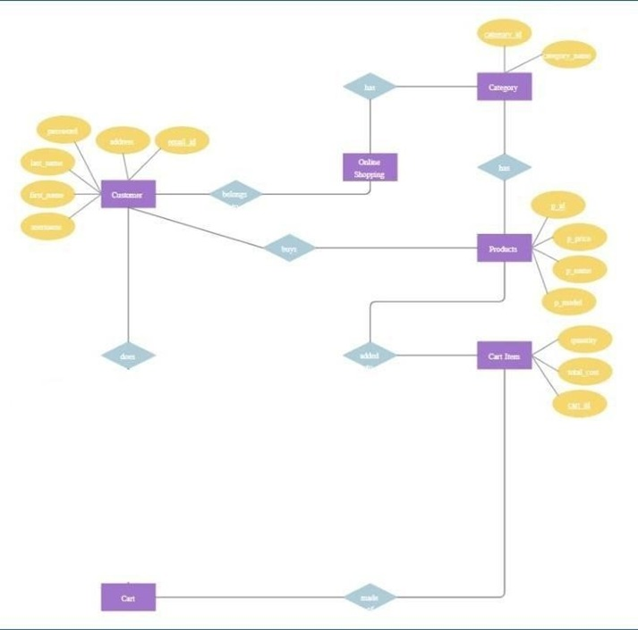
High-Level Architecture Diagram Of E-Commerce Site

Slide 10
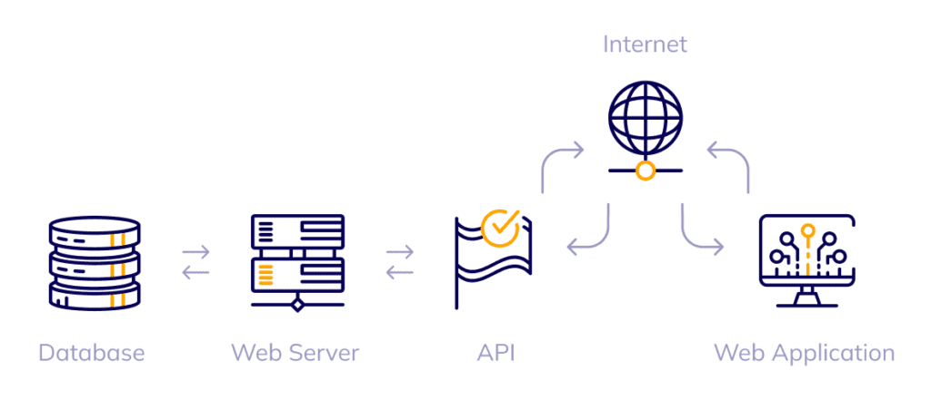
Role of APIs in E-Commerce
APIs (Application Programming Interfaces) play a crucial role in modern e-commerce platforms by enabling communication between different systems, services, and applications. They allow seamless integration of third-party services, improve scalability, and enhance customer experience. RESTful APIs & GraphQL are commonly used in e-commerce for efficient data exchange.

Slide 11
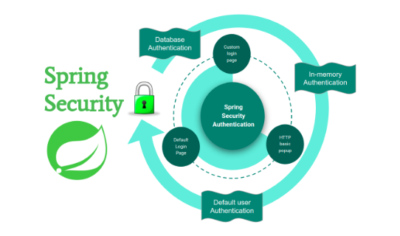
Security Measures in Spring Boot
Security is a critical aspect of any e-commerce platform, ensuring the protection of user data, transactions, and system integrity. Spring Boot provides built-in security mechanisms through Spring Security, OAuth, JWT, and encryption techniques.

Slide 12
User Authentication & Authorization
Authentication → Verifies "Who are you?" (User login).
Authorization → Determines "What are you allowed to do?" (User roles & permissions).
Implemented using Spring Security, JWT, OAuth2, Session-Based Auth, Role-Based Access Control (RBAC).
@Configuration
@EnableWebSecurity
public class SecurityConfig {
@Bean
public SecurityFilterChain securityFilterChain(HttpSecurity http) throws Exception {
http
.authorizeHttpRequests(auth -> auth
.requestMatchers("/admin/**").hasRole("ADMIN")
.requestMatchers("/user/**").hasRole("USER")
.anyRequest().authenticated()
)
.formLogin(Customizer.withDefaults())
.httpBasic(Customizer.withDefaults());
return http.build();
}
}

Slide 13
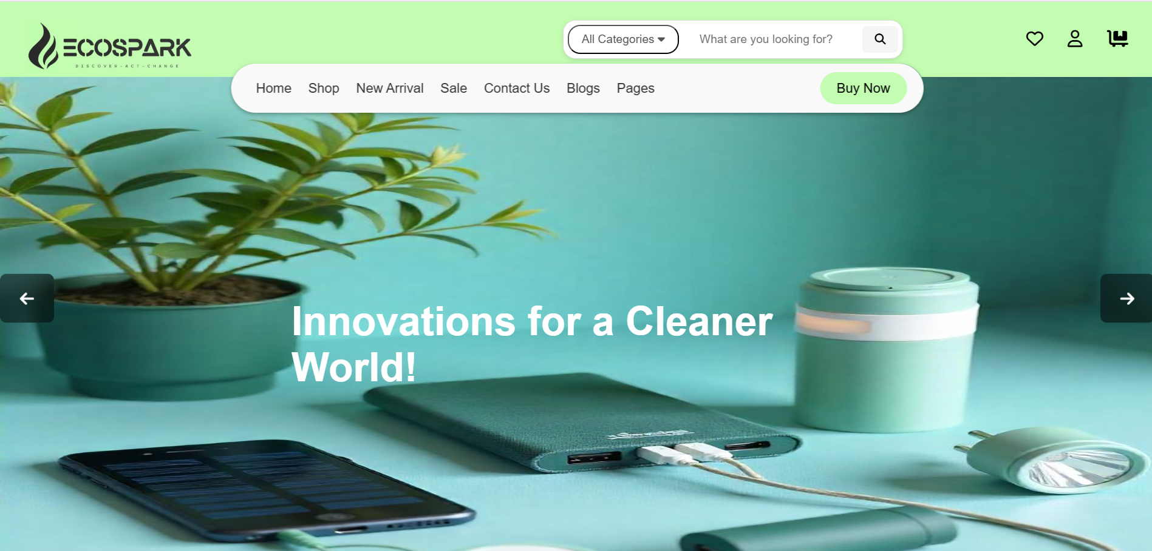
Homepage Design for a Solar Products E-Commerce Website

Slide 14
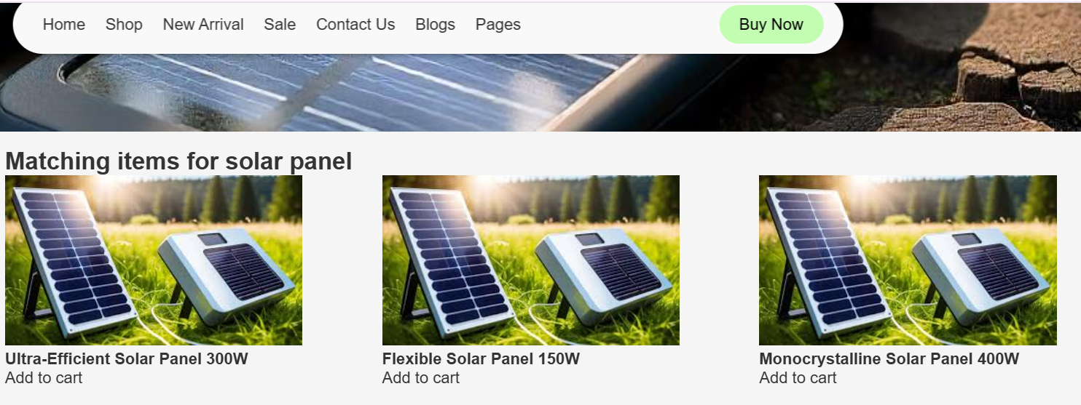
Product Listing Page Design for a Solar Products E-Commerce Website

Slide 15
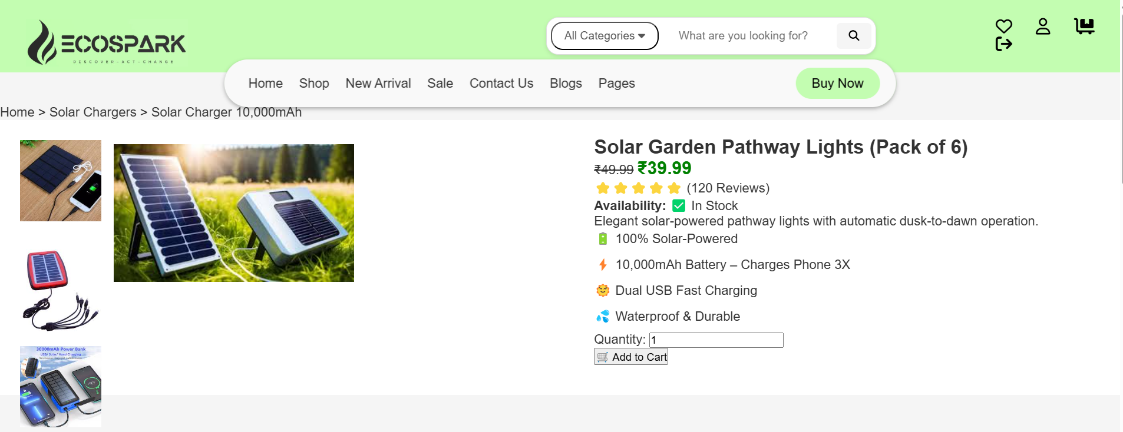
Product Detail Page Design for a Solar Products E-Commerce Website

Slide 16
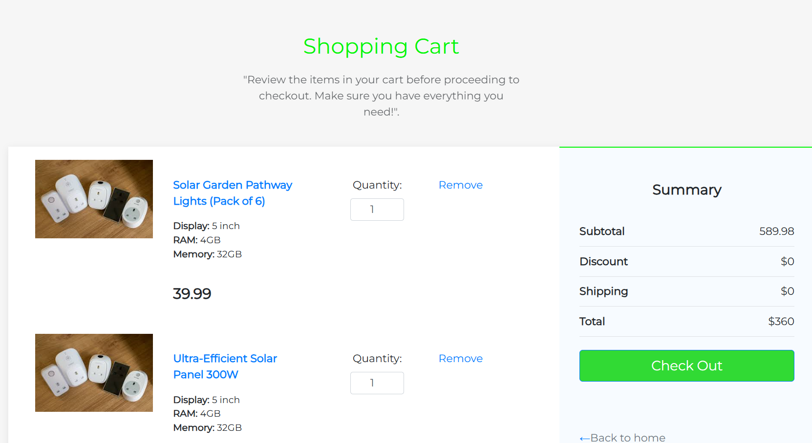
Cart and Checkout Page Design for a Solar Products E-Commerce Website

Slide 17
Database Schema for Products, Orders, and Users
CREATE TABLE product (
product_id VARCHAR(255) PRIMARY KEY,
category_id VARCHAR(255) NULL,
product_title VARCHAR(50) NOT NULL,
product_description TEXT NULL,
product_image_url TEXT NULL,
product_price DOUBLE NOT NULL,
product_stock INT DEFAULT 0,
created_date TIMESTAMP DEFAULT CURRENT_TIMESTAMP,
updated_date TIMESTAMP DEFAULT CURRENT_TIMESTAMP ON UPDATE CURRENT_TIMESTAMP,
created_by VARCHAR(255),
updated_by VARCHAR(255),
FOREIGN KEY (category_id) REFERENCES category(id)
);
CREATE TABLE user (
user_id INT PRIMARY KEY AUTO_INCREMENT,
user_name VARCHAR(255) NOT NULL,
user_email VARCHAR(255) UNIQUE NOT NULL,
user_password VARCHAR(255) NOT NULL,
user_address TEXT,
user_phone VARCHAR(20),
created_date TIMESTAMP DEFAULT CURRENT_TIMESTAMP,
updated_date TIMESTAMP DEFAULT CURRENT_TIMESTAMP ON UPDATE CURRENT_TIMESTAMP,
created_by VARCHAR(255),
updated_by VARCHAR(255)
);
CREATE TABLE product_order (
product_order_id VARCHAR(255) PRIMARY KEY,
user_id INT NOT NULL,
product_order_total_price DOUBLE NOT NULL,
product_order_status ENUM('PENDING', 'PROCESSING', 'SHIPPED', 'DELIVERED' ,'CANCELLED','CART') DEFAULT 'PENDING',
created_date TIMESTAMP DEFAULT CURRENT_TIMESTAMP,
updated_date TIMESTAMP DEFAULT CURRENT_TIMESTAMP ON UPDATE CURRENT_TIMESTAMP,
created_by VARCHAR(255),
updated_by VARCHAR(255),
FOREIGN KEY (user_id) REFERENCES user(id)
);

Slide 18
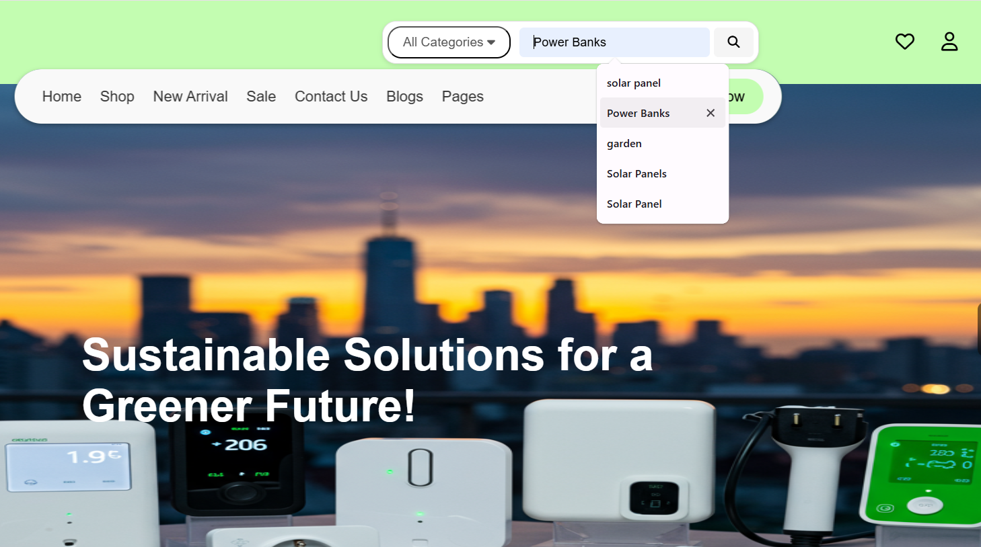
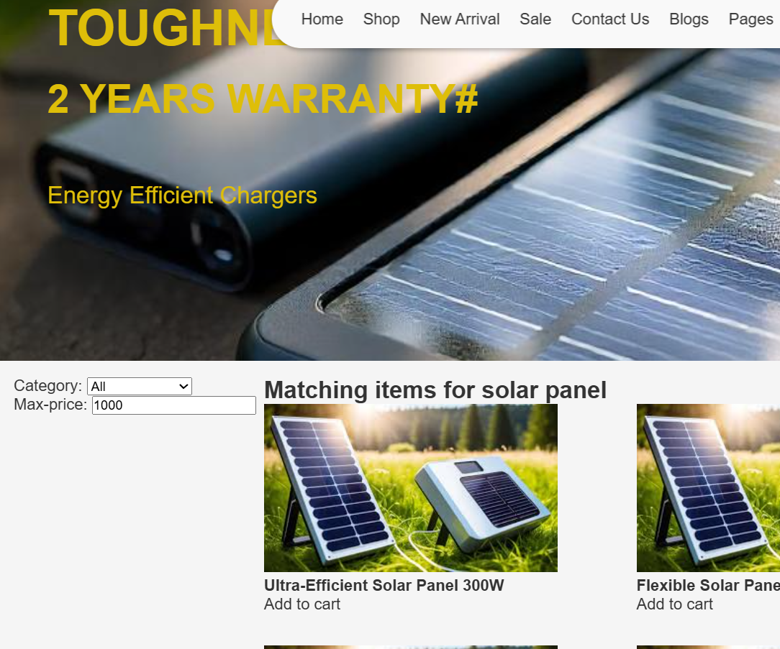
Search & Filter Functionality
The Search & Filter functionality is crucial for enhancing the user experience by helping customers quickly find relevant products. A well-optimized search and filtering system improves conversion rates and customer satisfaction.

Slide 19
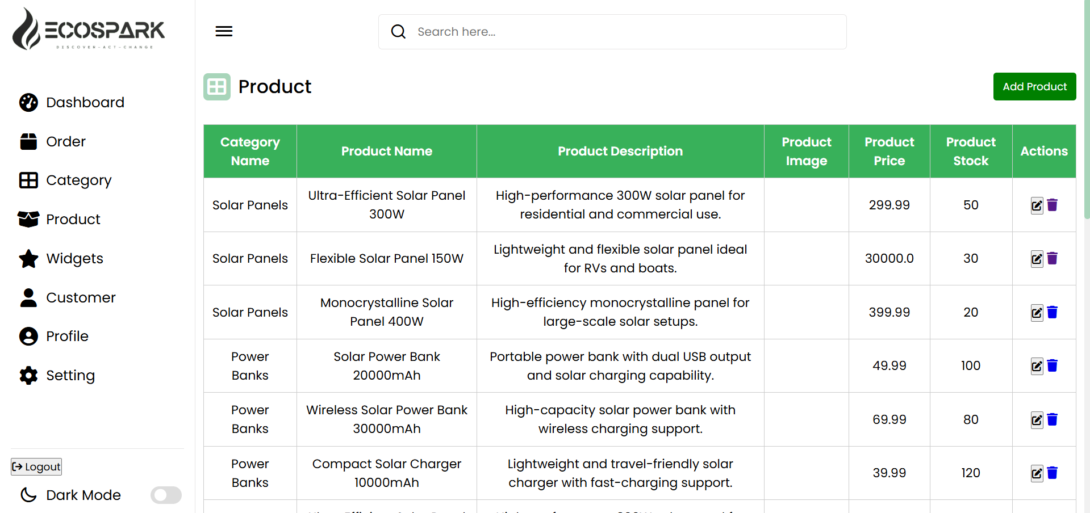
Admin Panel for Product Management
The Admin Panel is a crucial part of an e-commerce website, allowing administrators to manage products, orders, users, and inventory efficiently. In our Solar Products E-Commerce Site, the Admin Panel will be built using Spring Boot (backend) and HTML, CSS, JavaScript (frontend), providing a user-friendly interface for managing products.

Slide 20
Future Enhancement
AI-Powered Product Recommendations
Integration with IoT for Smart Solar Monitoring
Blockchain for Secure Transactions
IoT-Based Solar System Monitoring

Slide 21
User Roles (User, Admin)
Admin
Perform CRUD operations on Departments.
The admin has access to a centralized dashboard to monitor platform activity.
View and manage orders, including processing, cancellations, and refunds.
View and manage customer profiles, verify accounts, and handle disputes.
Create discount codes, seasonal sales, and special offers.
Enforce data protection policies, monitor fraudulent activities, and ban users if necessary.
Track sales, user activity, and product performance through reports.

Slide 22
User
Customers can create an account, log in securely, and manage their profile.
Users can search for solar products, apply filters, and compare items.
Users can add products to their cart or Wishlist for future purchases.
Secure checkout with multiple payment options (Credit Card, PayPal, UPI, etc.).
View order status (Pending, Shipped, Delivered, Canceled) in real-time.
Submit feedback and rate products after purchase. Users can request returns or refunds for eligible orders.

Slide 23
Challenges and Solution
1. Data Security & Privacy
Issue: Handling sensitive patient records securely while complying with healthcare regulations.
Solution: Implement encryption, multi-factor authentication (MFA), and compliance with data privacy laws (HIPAA, GDPR).
2. Challenge: System Scalability & Performance
Issue: High traffic can slow down the platform, affecting user experience.
Solution: Use cloud-based solutions, load balancing, and optimized database management.

Slide 24
Conclusion
Developing a solar products e-commerce platform using HTML, CSS, JavaScript, Spring Boot, and a database presents both opportunities and challenges. The platform aims to bridge the gap between eco-conscious consumers and high-quality solar products, promoting sustainability while ensuring a seamless shopping experience. Through this journey, we explored key aspects of frontend development, backend integration, security measures, database management, and order processing. The challenges encountered—ranging from user experience optimization, payment security, search performance, scalability, and authentication—highlight the complexities involved in building a robust e-commerce solution. However, by implementing best practices and modern technologies, these challenges can be efficiently tackled.

Slide 25
Thank You

